Slide 1
Morphological Image Analysis
Dr. Vivek Venugopal
Assistant Professor
ECE Department

Slide 2
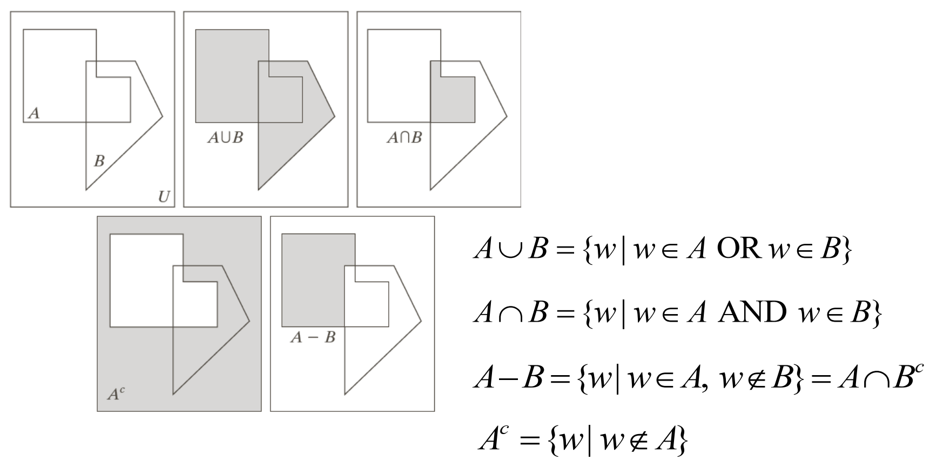
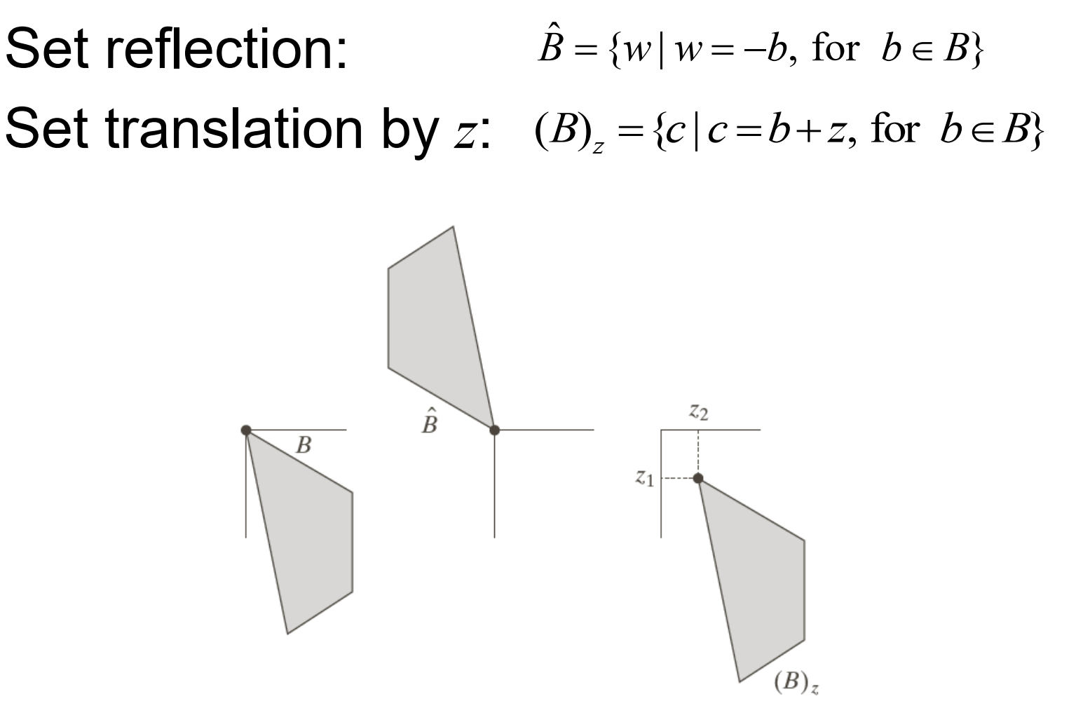
Introduction
Morphology provides tools for the representation and description of image regions
Provides techniques for pre- and postprocessing of an image.
Principles are based on set theory
Applications to both binary and gray-level images

Slide 3
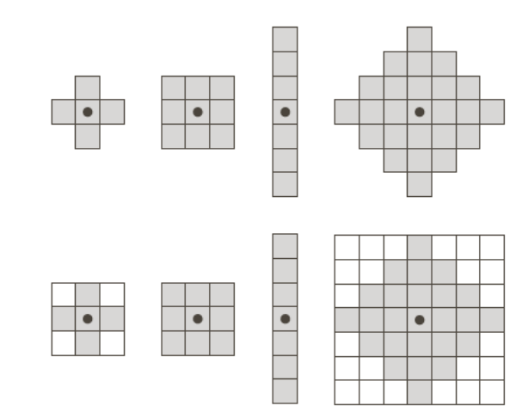
Structuring Elements
Set reflection and translation are employed to structuring elements (SE).
SE are small sets or sub-images used to examine the image under study for properties of interest.
The origin must be specified. Zeros are appended to SE to give them a rectangular form.
Gray colour represents a value of one and white colour a zero value.

Slide 4
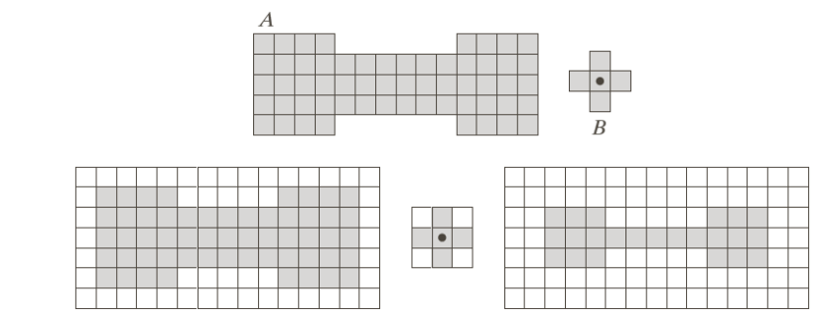
Structuring Elements
The origin of the SE B visits every pixel in an image A. It performs an operation (generally nonlinear) between its elements and the pixels under it.
It is then decided if the pixel will belong to the resulting set or not based on the results of the operation.
Zero padding is necessary (like in convolution) to ensure that all of the elements of A are processed.
For example, it marks the pixel under its center as belonging to the result if B is completely contained in A.

Slide 5
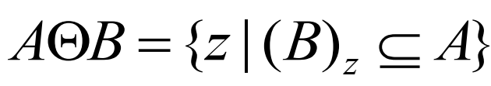
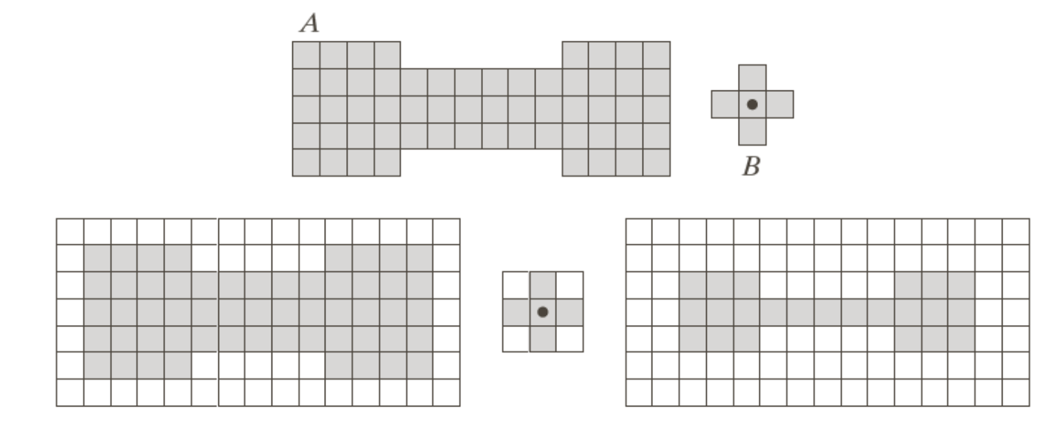
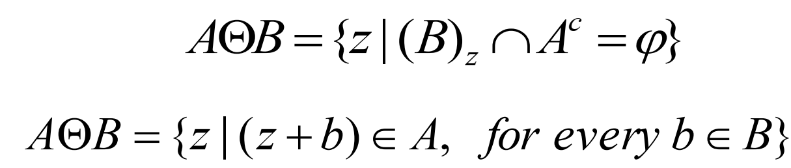
Erosion
The erosion of a set A by a SE B is defined as
The result is the set of all points z such that B translated by z is contained in A.
Equivalently:
Erosion is a shrinking operation

Slide 6
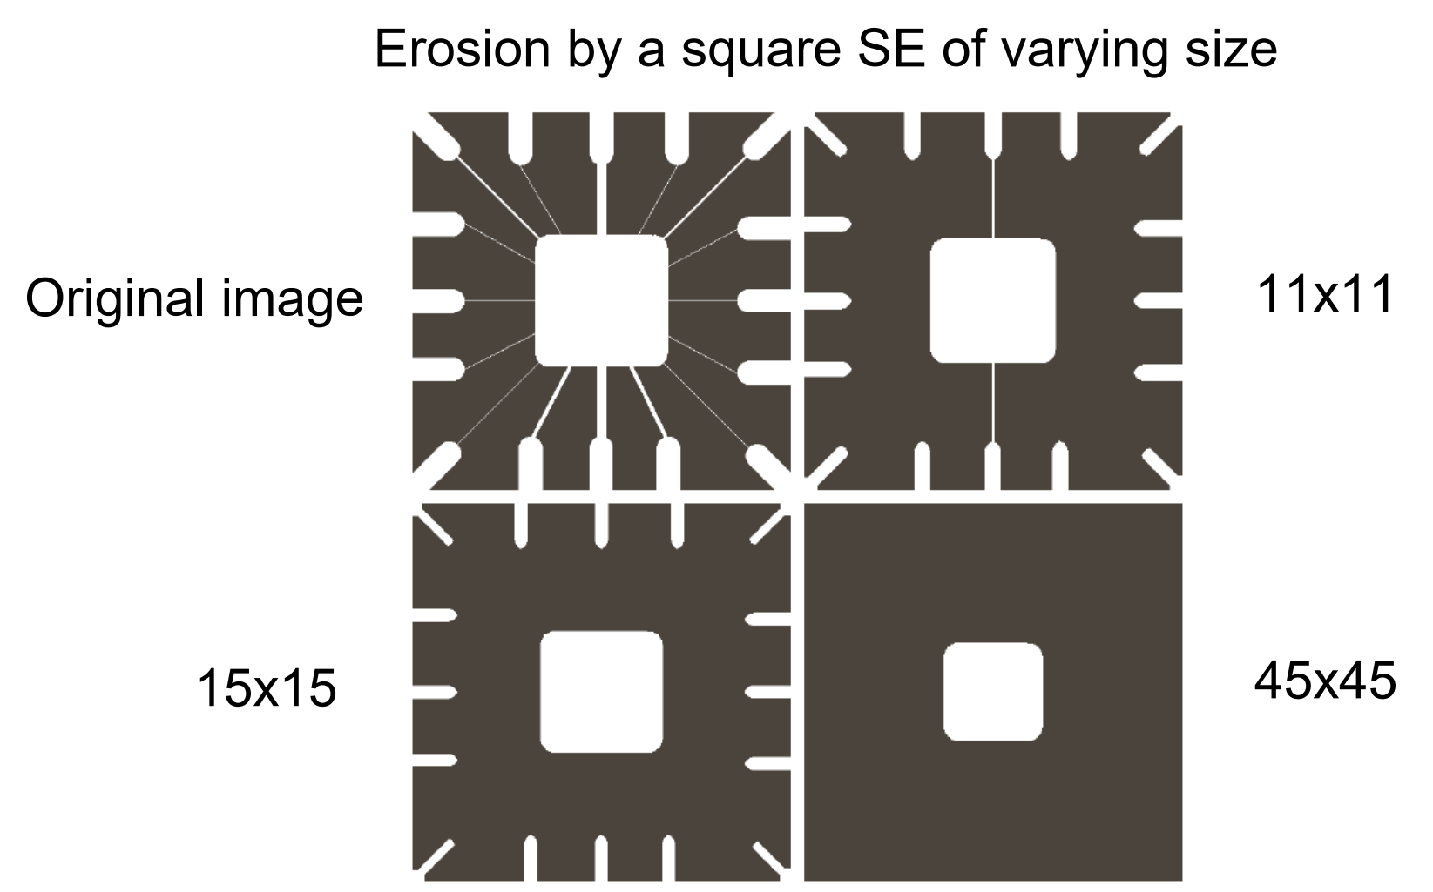
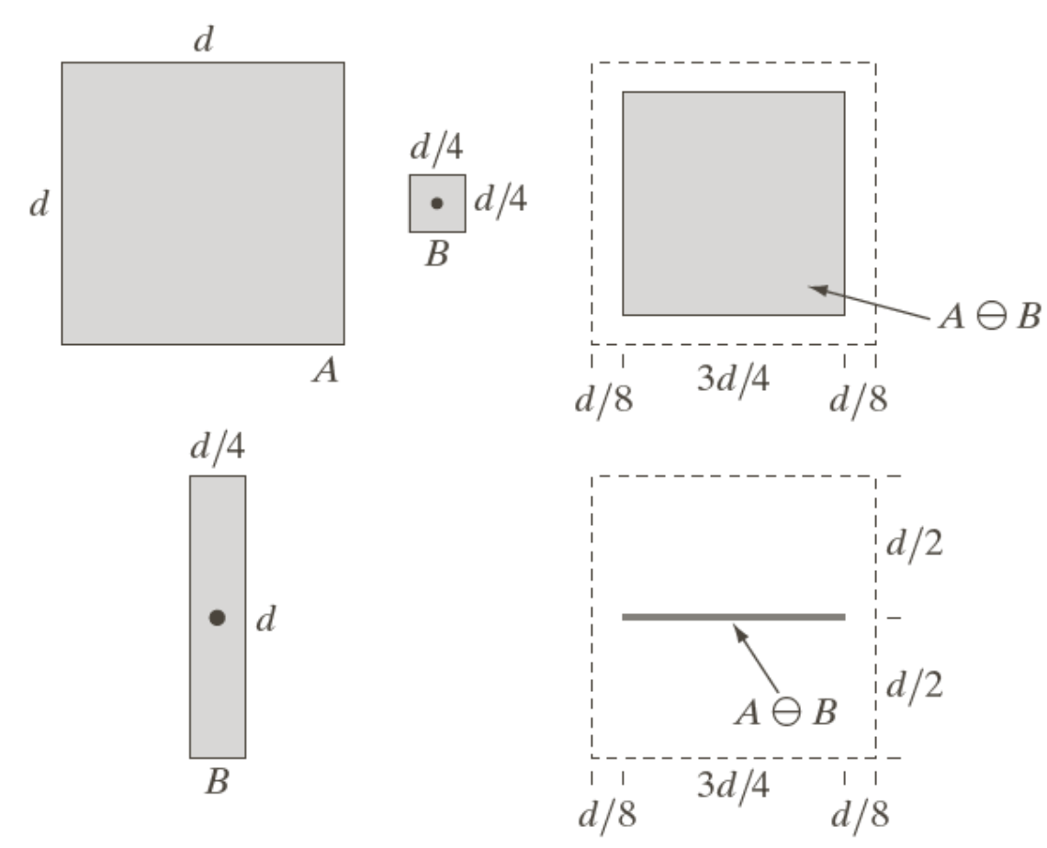
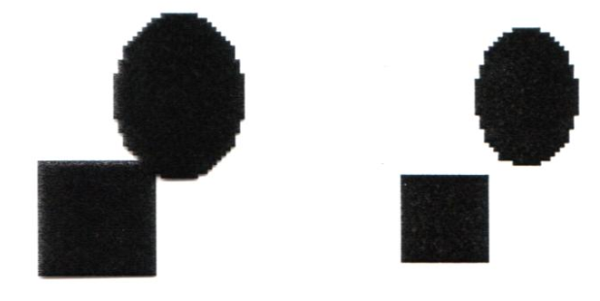
Erosion
Erosion can split apart joint objects

Slide 7
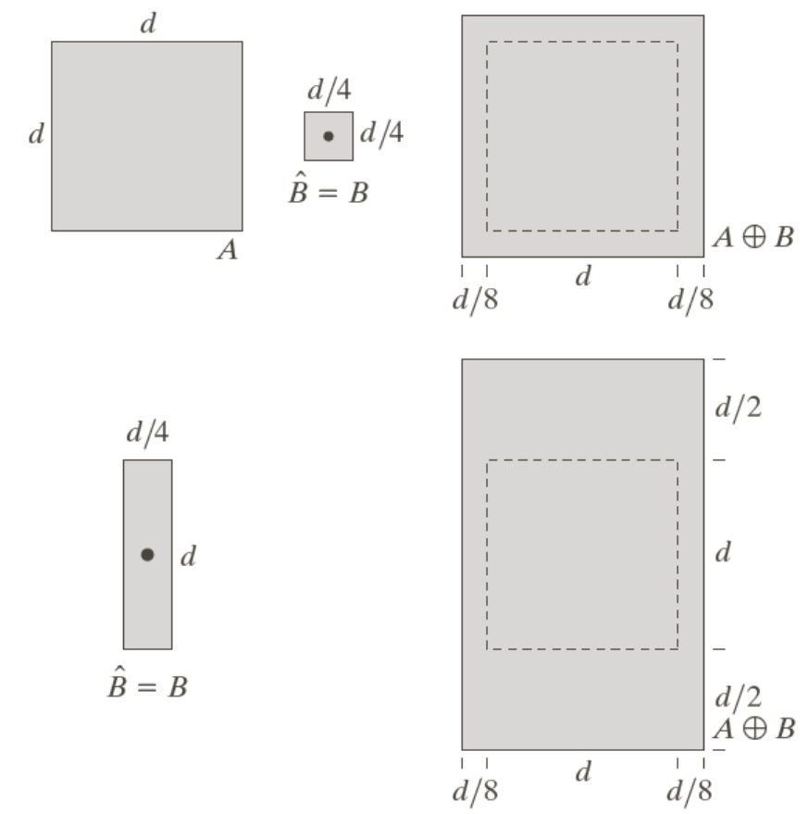
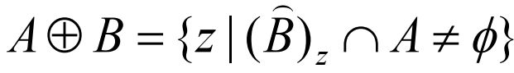
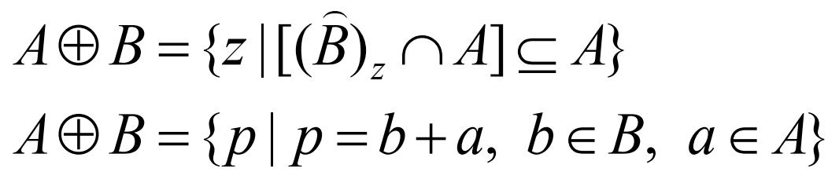
Dilation
The dilation of a set A by a SE B is defined as
The result is the set of all points z such that the translation of the reflected B overlap with A at atleast one element. Equivalently:
Dilation is a thickening operation

Slide 8
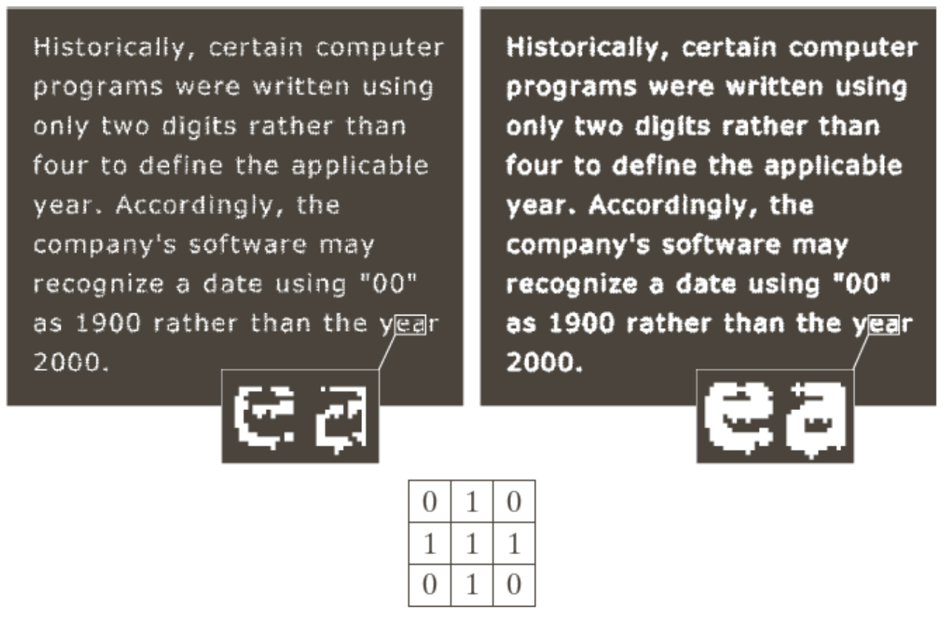
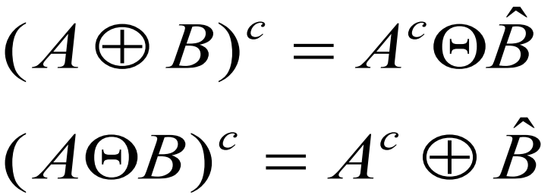


Dilation
Dilation can repair intrusions and enlarges objects
Erosion and dilation are dual operations with respect to set complementation and reflection:
Also,
The duality is useful when the SE is symmetric: The erosion of an image is the dilation of its background.

Slide 9
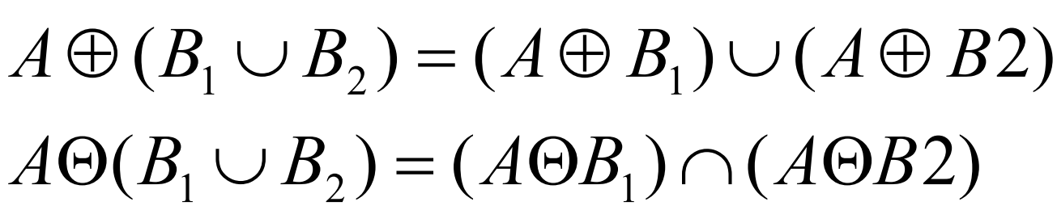
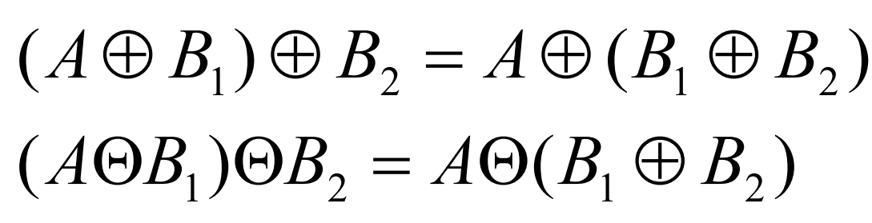
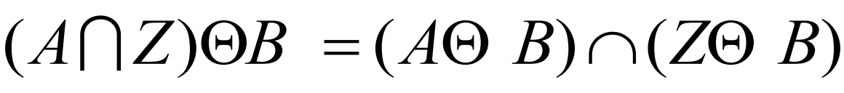
Dilation
They are translation invariant. Translation of object causes same shift in output.
They are not inverses of each other
Distributivity
Iteration
Local knowledge:

Slide 10
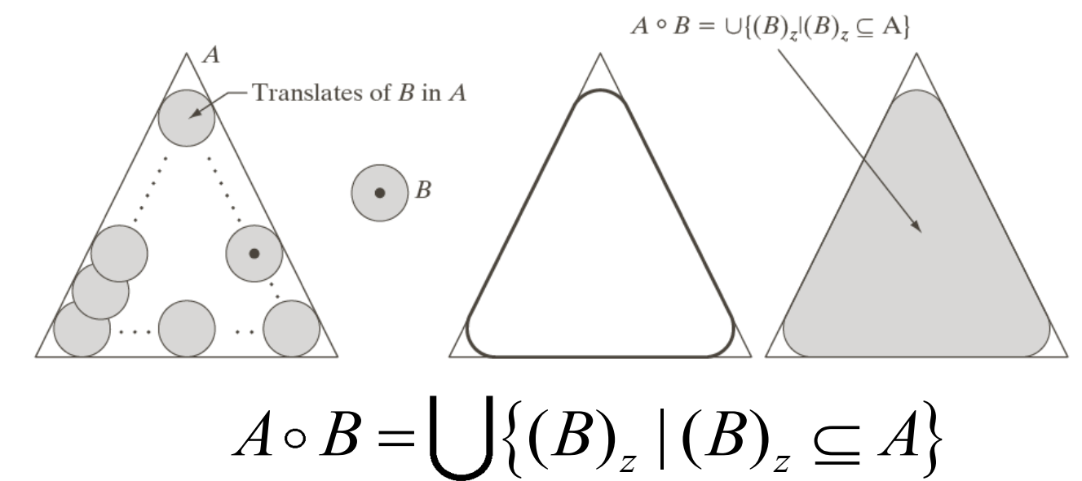
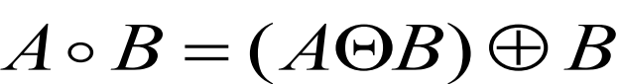
Compound Operations
More interesting morphological operations can be performed by combining erosions and dilations in order to reduce shrinking or thickening.
The most widely used of these compound operations are:
– Opening
– Closing
The opening of set A by structuring element B is defined as
which is an erosion of A by B followed by a dilation of the result by B
Geometric interpretation: The boundary of the opening is defined by points of the SE that reach the farthest into the boundary of A as B is “rolled” inside of this boundary.

Slide 11

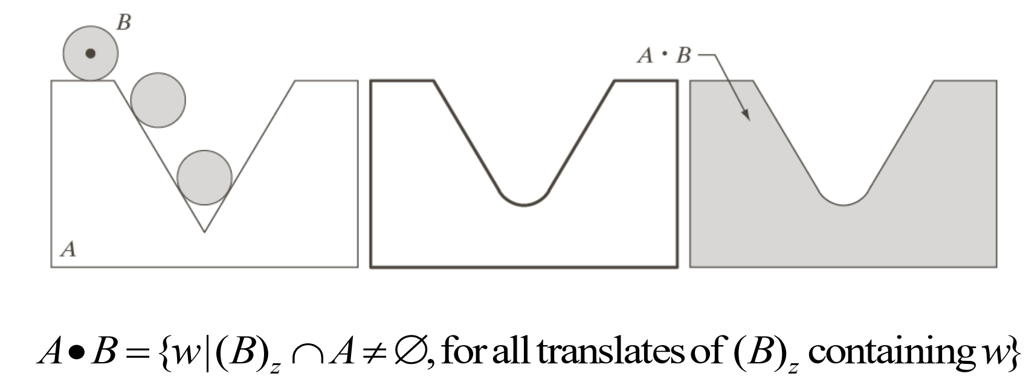
Closing
The closing of set A by structuring element B is defined as
which is a dilation of A by B followed by an erosion of the result by B.
It has a similar geometric interpretation except that B is rolled on the outside of the boundary:

Slide 12
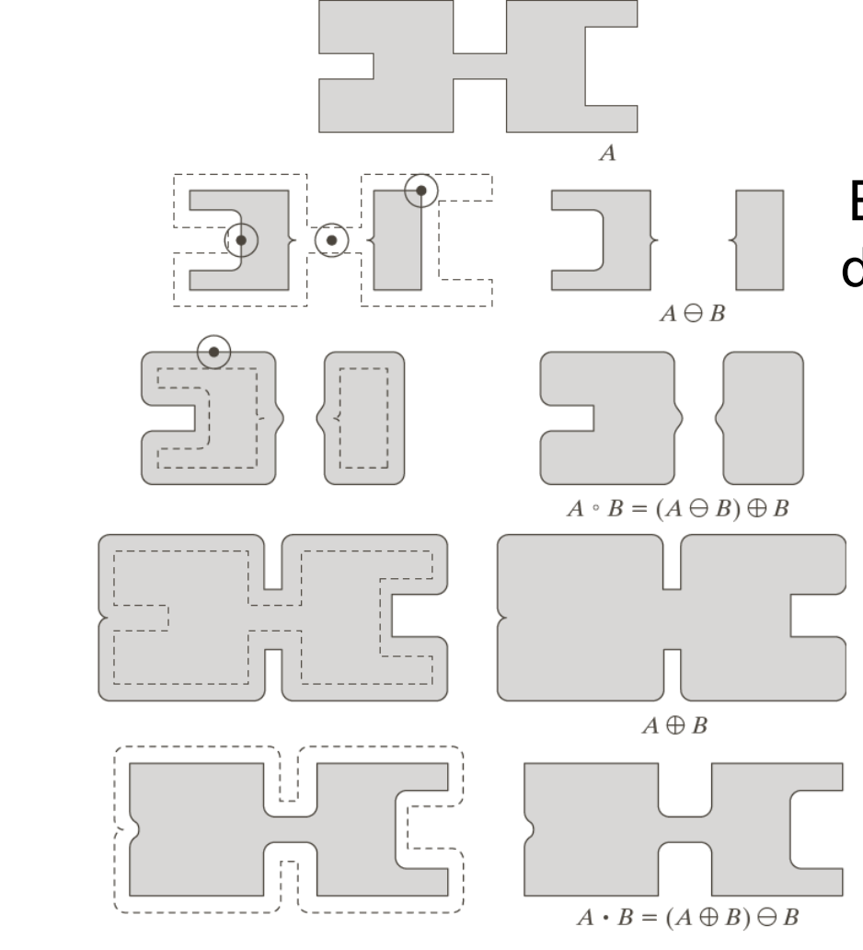
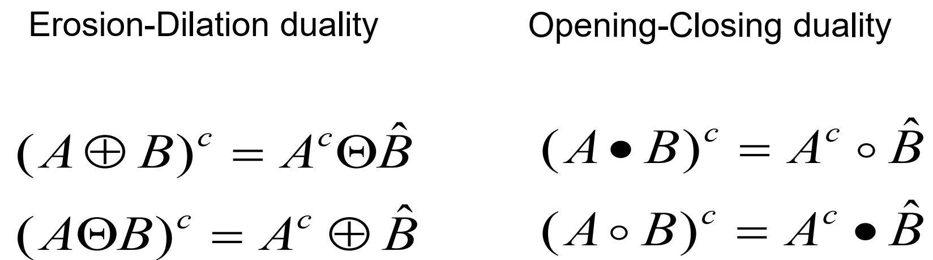
Opening and Closing
Erosion: elements where the disk can not fit are eliminated
Opening: outward corners are rounded
Dilation: inward intrusions are reduced in depth
Closing: inward corners are rounded
Opening and closing are dual operations.

Slide 13
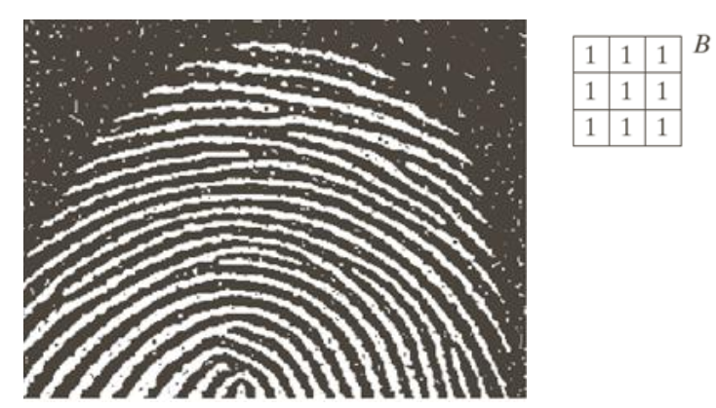
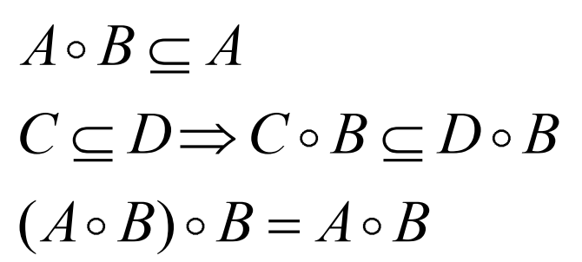
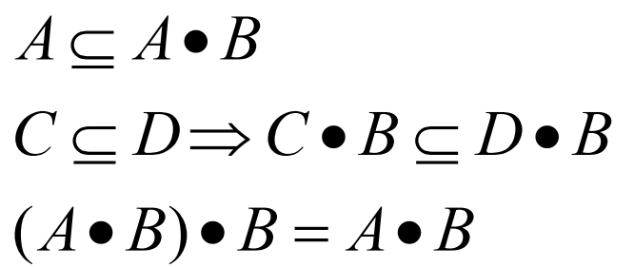
Opening and Closing
Opening:
Closing:
The last properties, in each case, indicate that multiple openings or closings have no effect after the first application of the operator
The image contains noise: Light elements on dark background and Dark elements on the light components of the fingerprint.
Objective: Eliminate noise while distorting the image as little as possible.
We will apply an opening followed by closing.

Slide 14
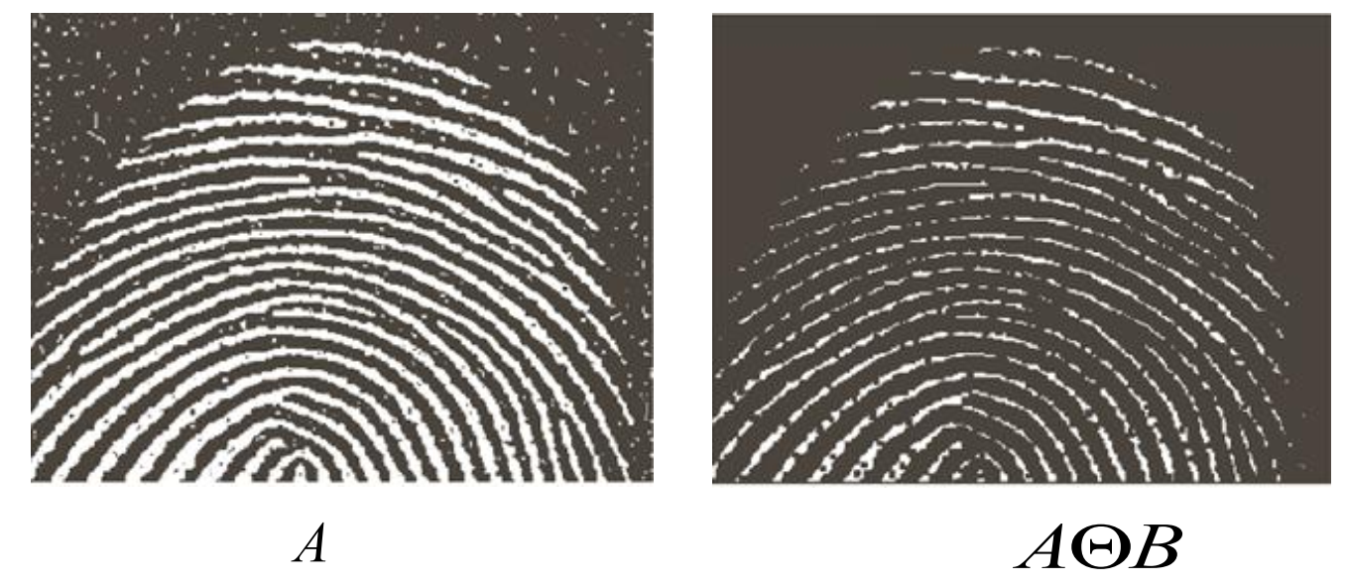
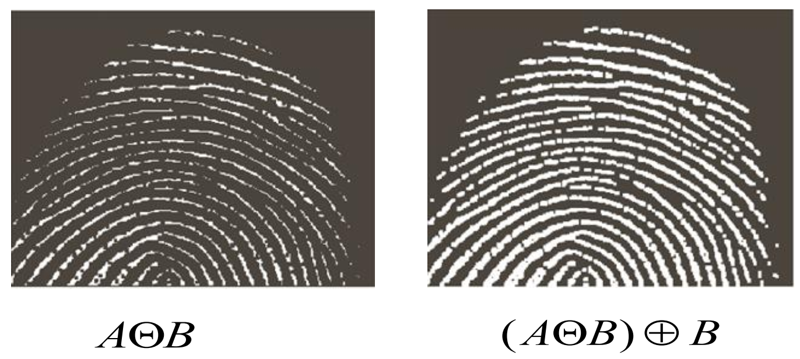
Opening and Closing
Background noise completely removed (noise components smaller than the SE).
The size of the dark noise elements in the fingerprint structure increased (inner dark structures).
The dilation reduced the size of the inner noise or eliminated it completely.
However, new gaps were created by the opening between the fingerprint ridges.

Slide 15
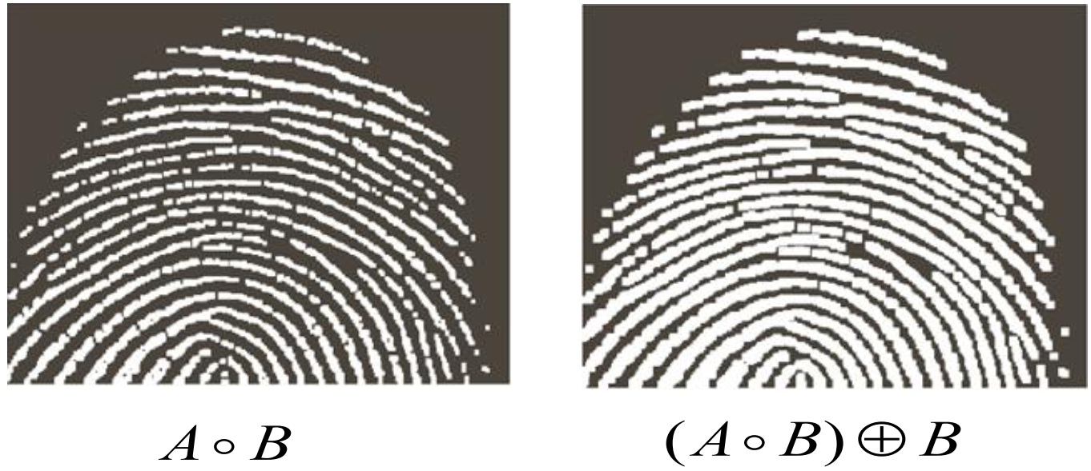
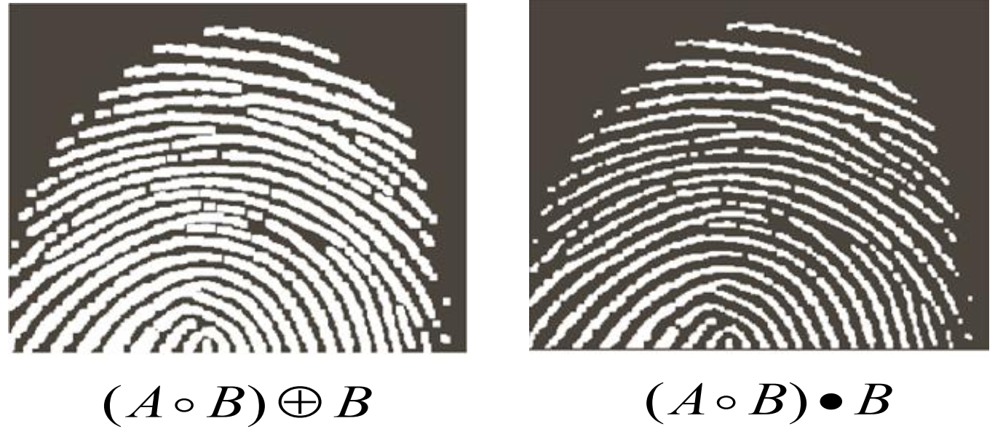
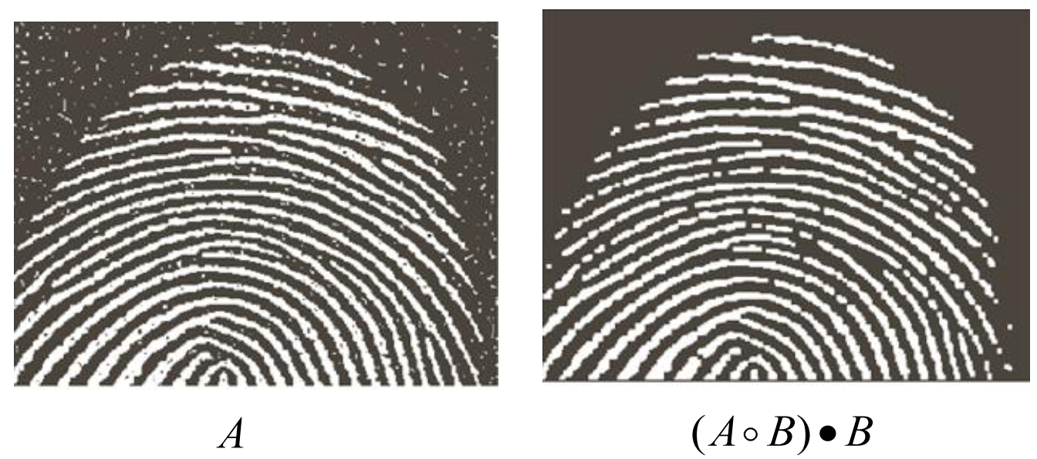
Opening and Closing
The dilation reduces the new gaps between the ridges but it also thickens the ridges.
The final erosion (resulting to a closing of the opened image) eliminates makes the ridges thinner.
The final result is clean of noise but some ridges were not fully repaired.
We should impose conditions for maintaining the connectivity (we will see a more advanced algorithm).

Slide 16
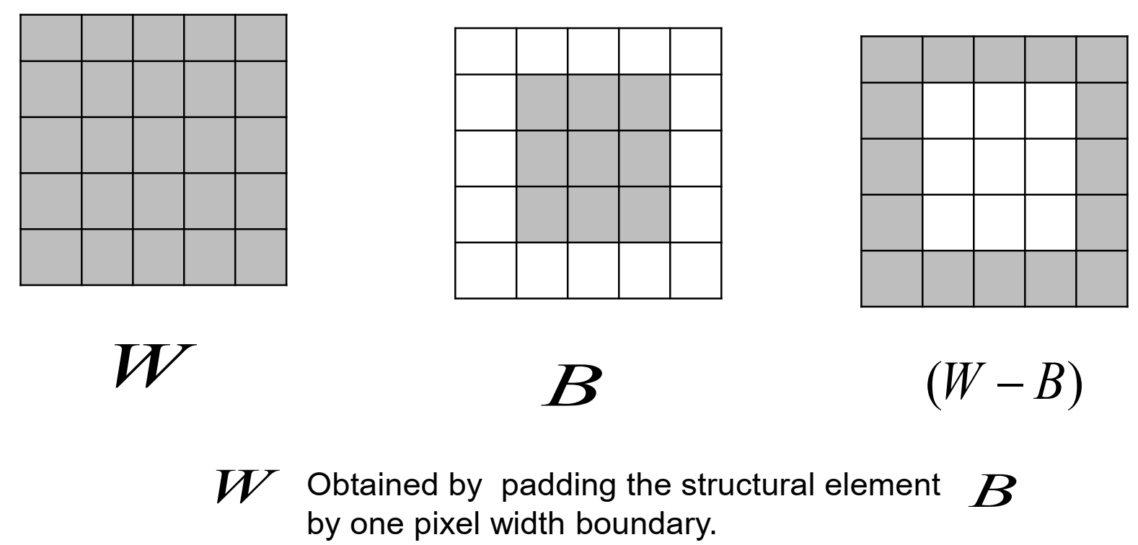
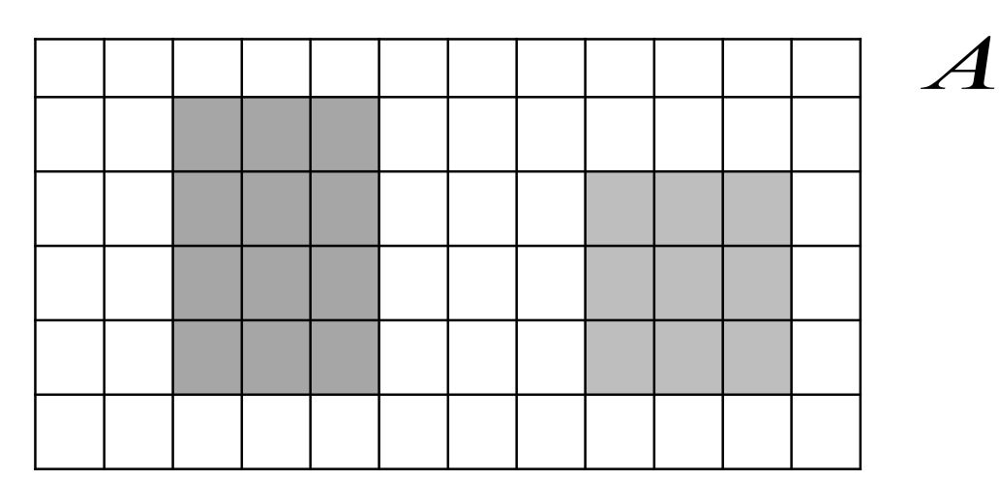
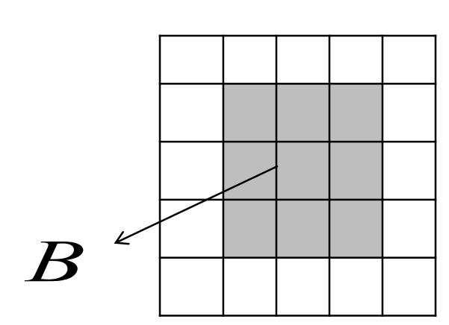
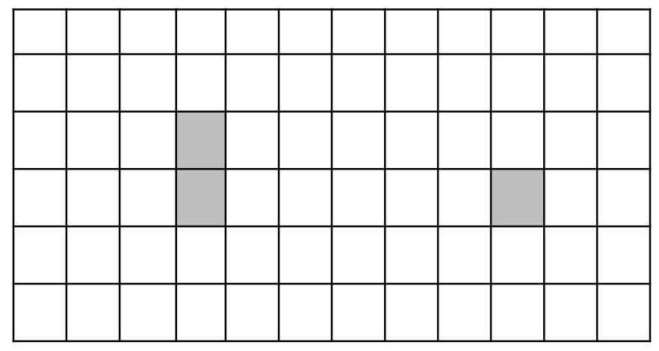
Hit or Miss transformation
Basic tool for shape detection.
It is the set of all locations that B found a match (hit) in A.

Slide 17
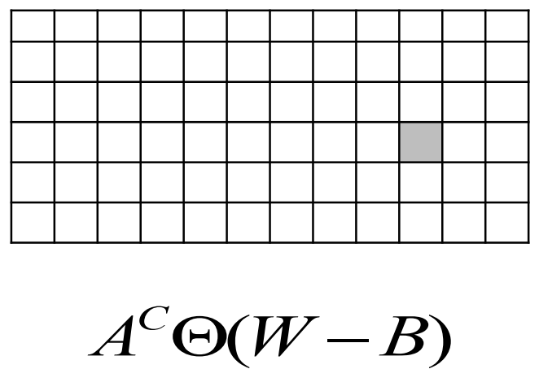
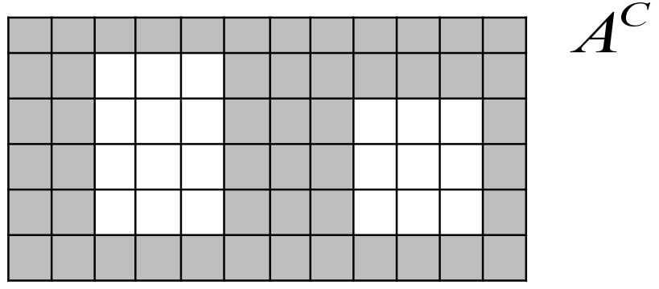
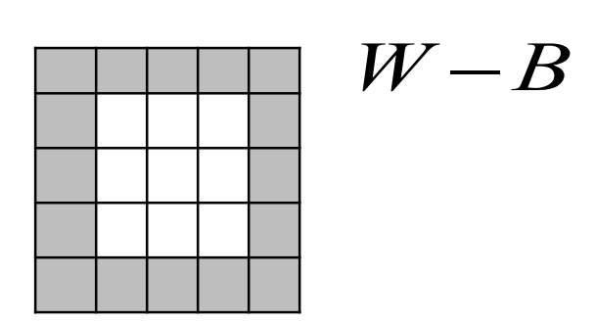
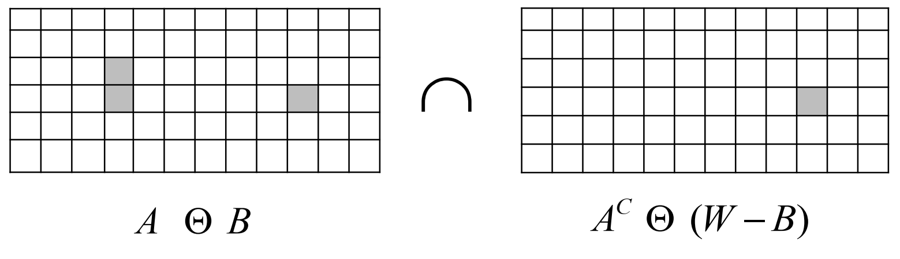
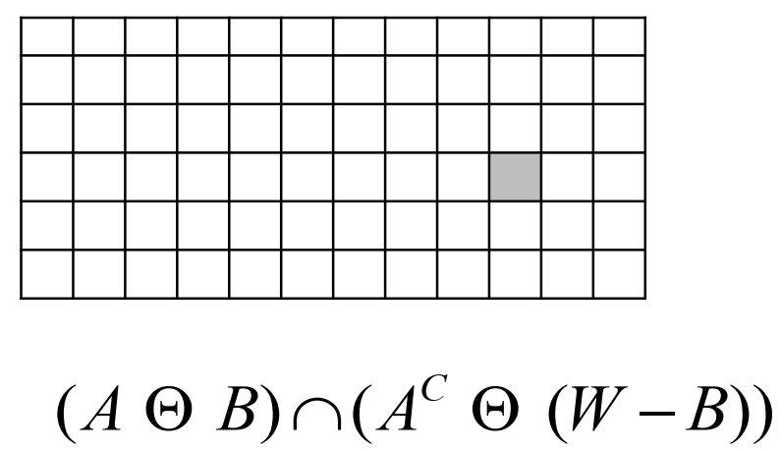
Hit or Miss transformation

Slide 18
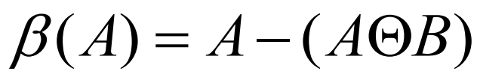
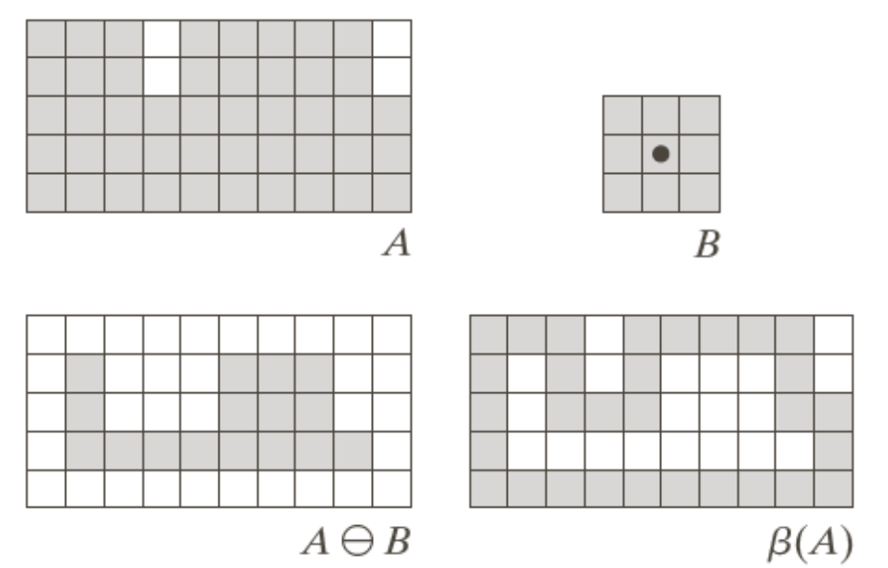
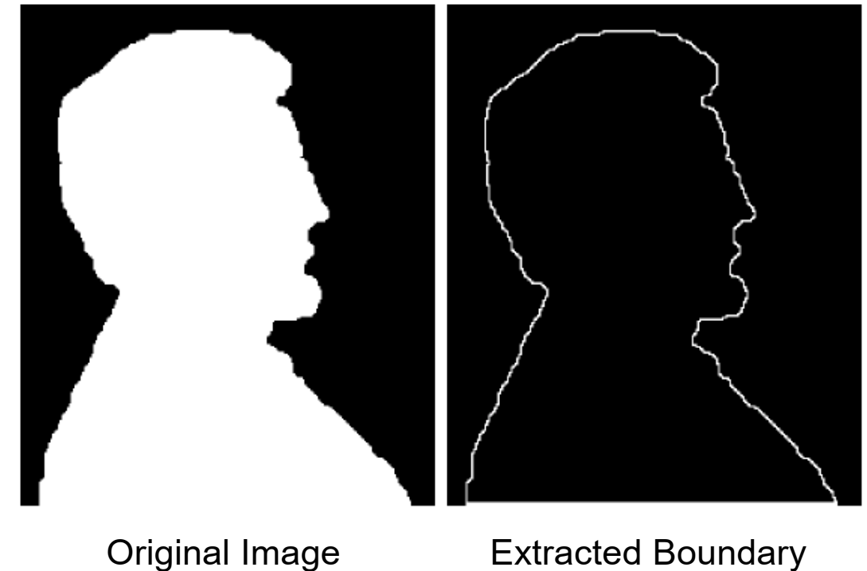
Boundary extraction
Using morphological operations we may extract image components for shape representation such as Shape boundaries, Region filling, Connected components.
The boundary is one pixel thick due to the 3x3 SE. Other SE would result in thicker boundaries.
The boundary of a set A, denoted by β(A), may be obtained by:

Slide 19
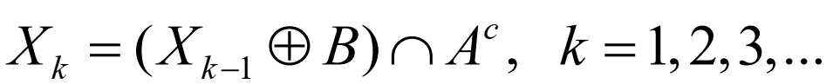
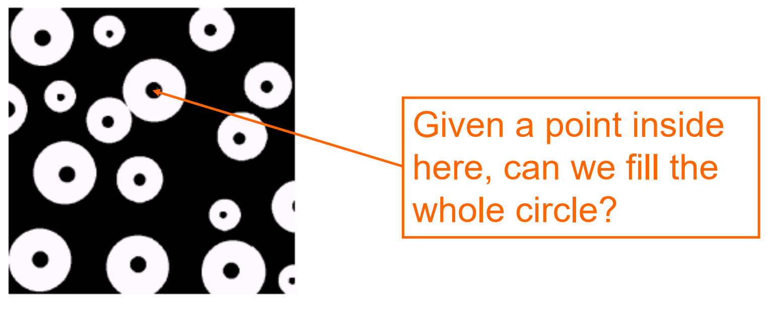
Region filling
Given a pixel inside a boundary, region filling attempts to fill the area surrounded by that boundary with 1s.
Form a set X₀ with zeros everywhere except at the seed point of the region. Then,
Where B is a 3x3 cross-shaped SE.
The algorithm terminates when X_{k}=X_{k-1}. The set union of X_{k} and A contains all the filled holes and their boundaries.
This is a first example where the morphological operation (dilation) is conditioned.
The intersection of the result with the A^{c} limits the result inside the region of interest.

Slide 20
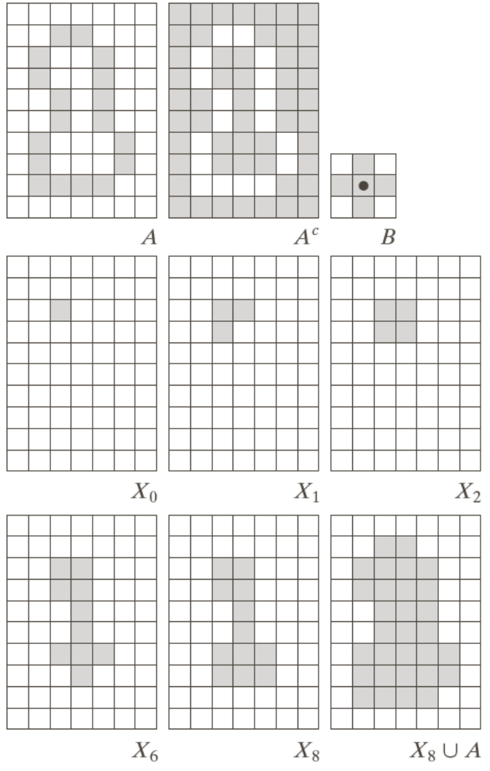
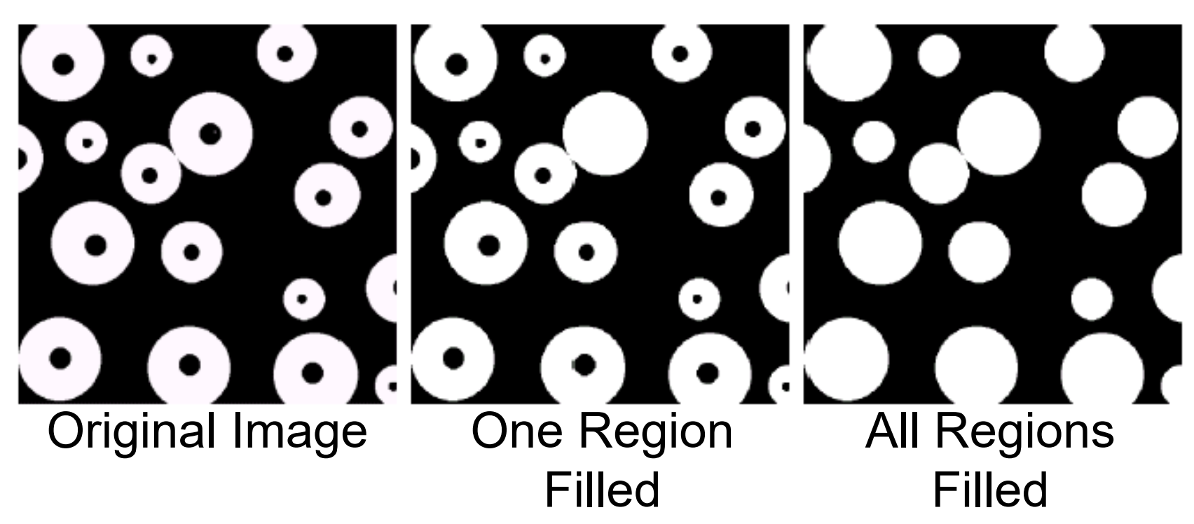
Region Filling

Slide 21
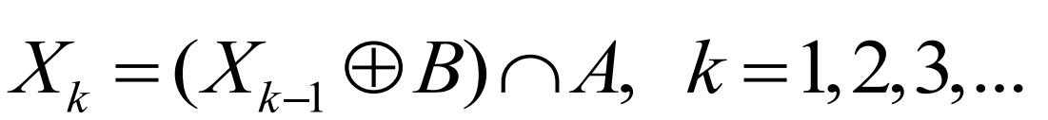
Extraction of connected components
•Given a pixel on a connected component, find the rest of the pixels of that component.
•The algorithm may be applied to many connected components provided we know a pixel on each one of them.
•Disadvantage: We have to provide a pixel on the connected component.
•There are more sophisticated algorithms that detect the number of components without manual interaction. The purpose here is to demonstrate the flexibility of mathematical morphology.
Form a set X₀ with zeros everywhere except at the seed point of the connected components. Then,
Where B is a 3x3 square-shaped SE. The algorithm terminates when X_{k}=X_{k-1}. All the connected components are contained in X_{k}

Slide 22
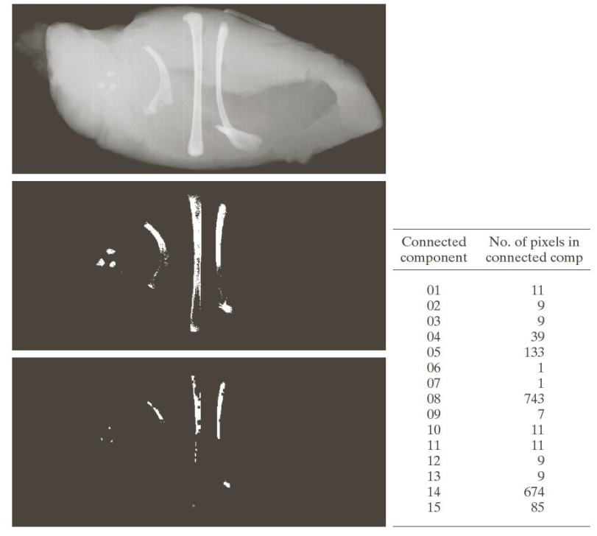
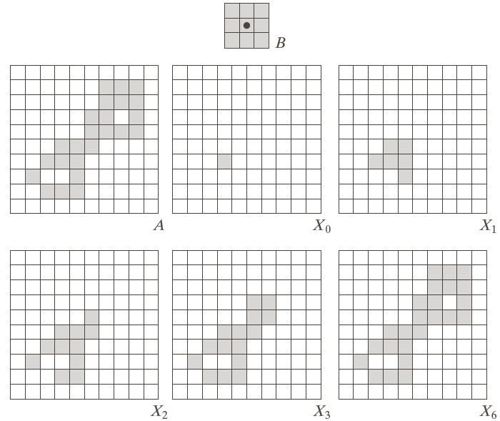
Extraction of connected components
Note the similarity with region filling. The only difference is the use of A instead of A^{c}. This is not surprising as we search for foreground objects.
Image of chicken filet / slice containing bone fragments
Result of simple thresholding
Image erosion to retain only objects of significant size.
15 connected components detected with four of them being significant in size.

Slide 23


Gray scale Morphology
The image f(x,y) and the SE b(x,y) take real or integer values.
SE may be flat or non-flat.
Set reflection:
The erosion of image f by a flat SE b at any location (x,y) is defined as the minimum value of the image in the region coincident with b when the origin of b is at (x,y):
In practice, we place the center of the SE at every pixel and select the minimum value of the image under the window of the SE.

Slide 24

Gray level Dilation
The dilation of image f by a flat SE b at any location (x,y) is defined as the maximum value of the image in the window outlined by b:
The SE is reflected as in the binary case.
The erosion of image f by a non-flat SE b is defined as:
The dilation of image f by a non-flat SE b is defined as:
When the SE is flat the equations reduce to the previous formulas up to a constant.

Slide 25


Gray level Opening and Closing

